Slide 1
Subcommittee on Minnesota Water Policy
Soil & Water Conservation Districts (SWCD) Funding Overview
By LeAnn Buck,
Minnesota Association of Soil & Water Conservation Districts
January 15, 2020

Slide 2
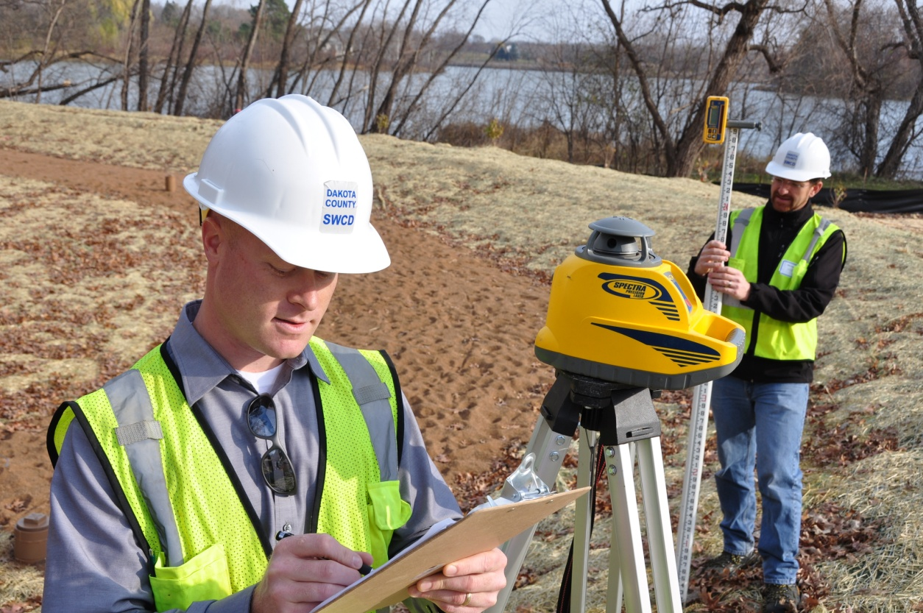
MN Soil & Water Conservation Districts
Minnesota SWCD Powers & duties (MN State Statute 103C)
A SWCD is a legal subdivision of the state

Slide 3
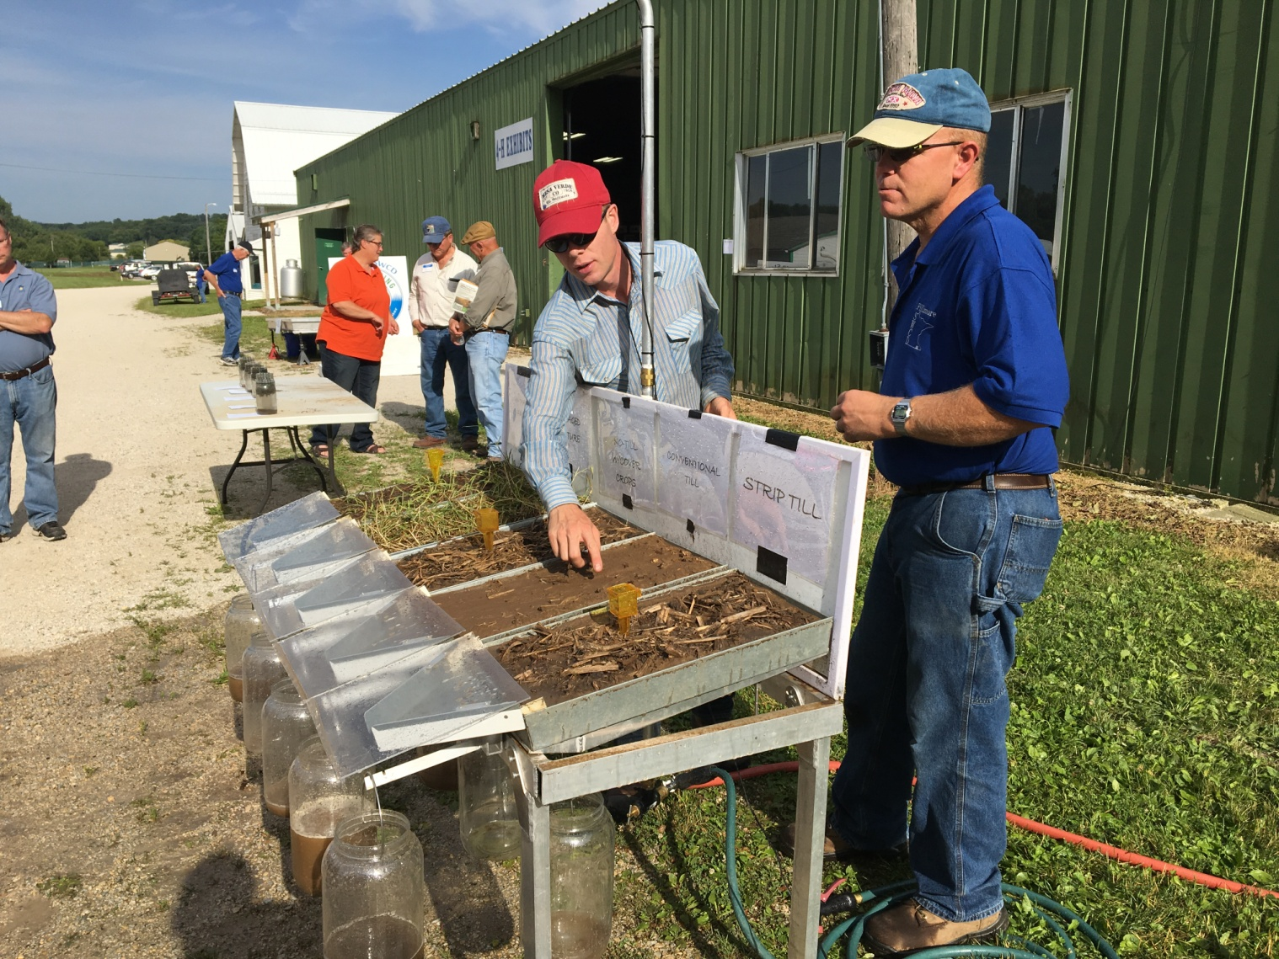
SWCDs…
Private Lands Conservation
Voluntary Incentive Programs
Conservation Education

Slide 4
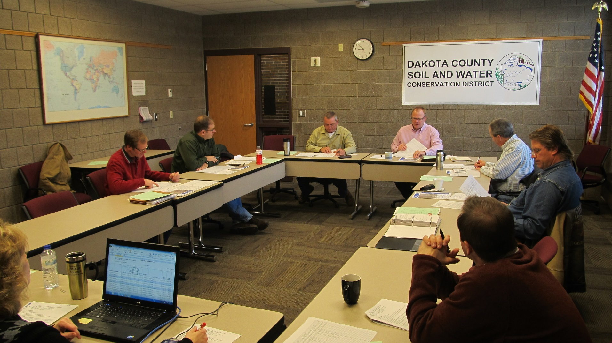
SWCDs Governed by Elected Board Members

Slide 5
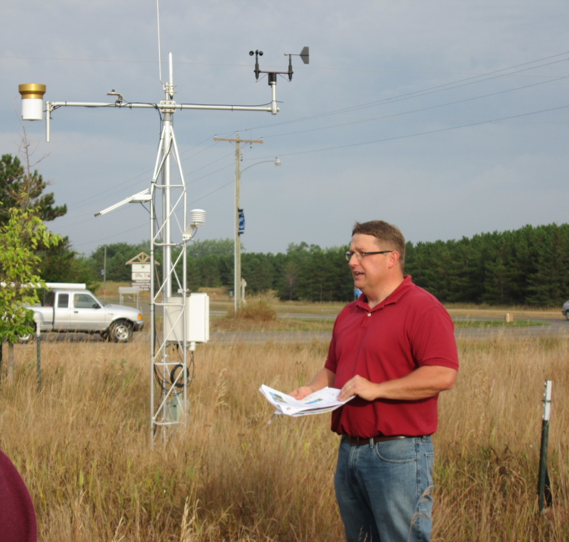
SWCDs Have Resource Professionals

Slide 6
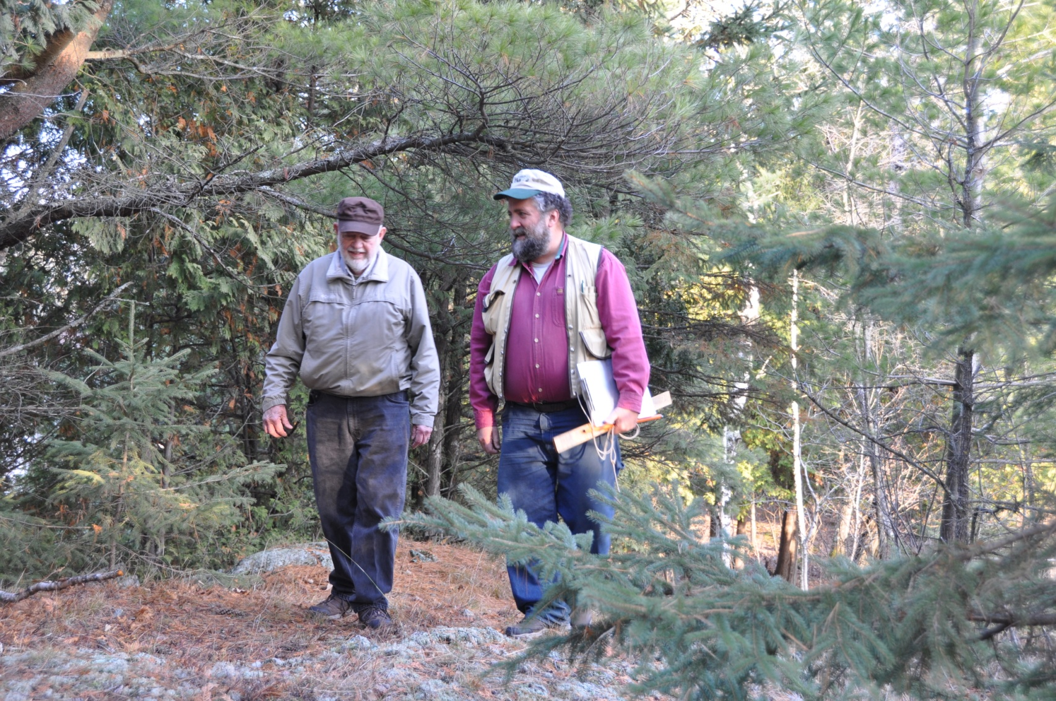
SWCDs Work with Landowners

Slide 7
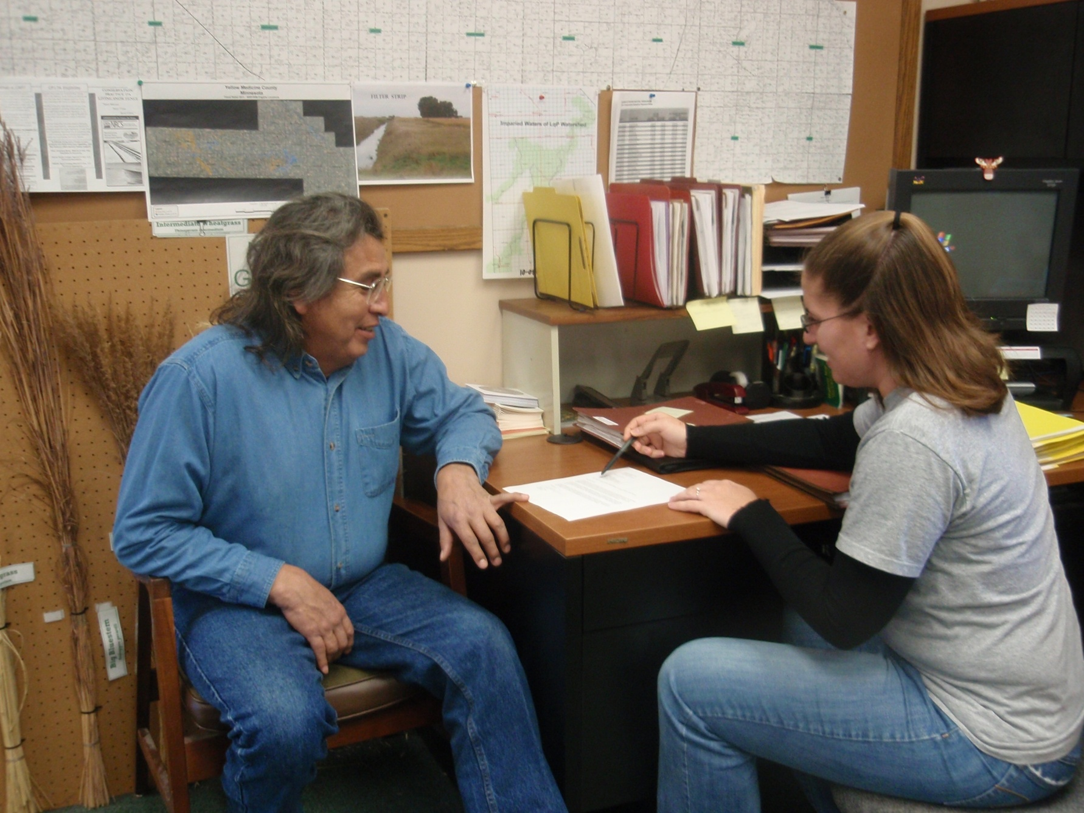
SWCDs Cost-Share: Landowner by Landowner (field by field)
Notes:
Of the 88 SWCDs, 70 co-located with USDA

Slide 8
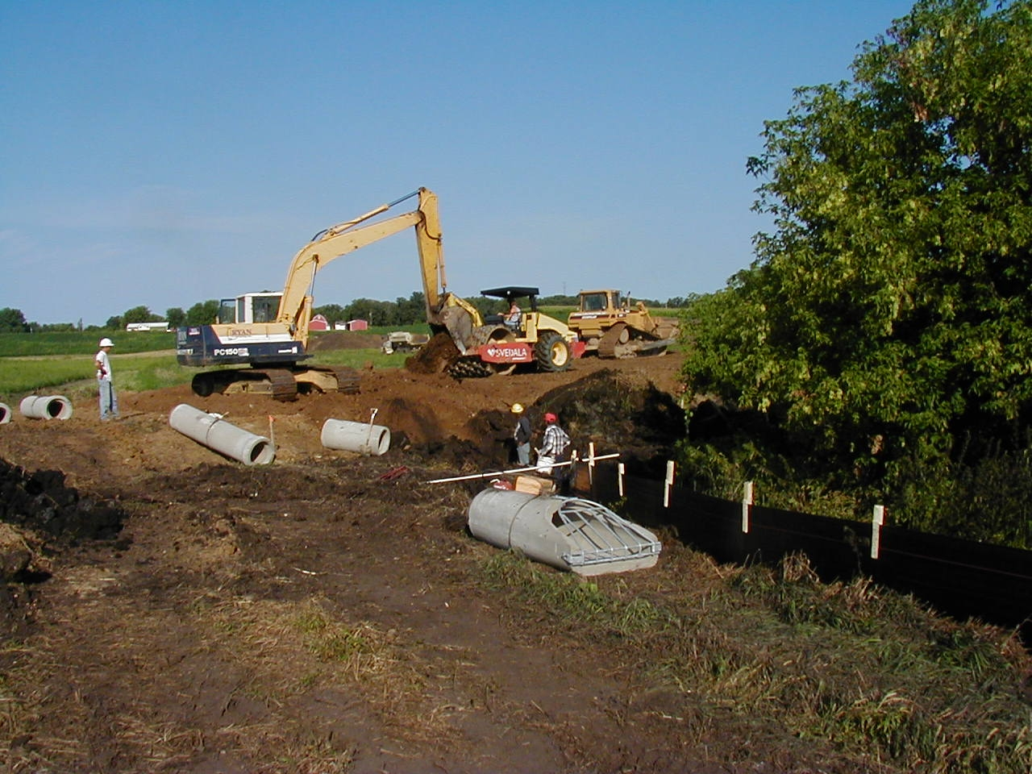
SWCDs & Landowners Implementing Practices

Slide 9
SWCDs & State
Soil Erosion & Riparian Protection
Wetland Conservation Act
Reinvest In Minnesota (RIM Reserve)
Comprehensive Water Management & One Watershed One Plan
Ag Water Quality Certification
Cooperative Agreements with USDA NRCS (leveraging & local priorities)

Slide 10
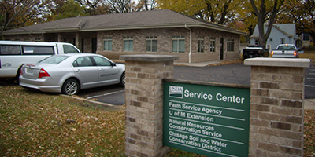
SWCD Funding Sources
County (may fund)
State Grants (mostly project)
Self Generated
Leverage Federal

Slide 11
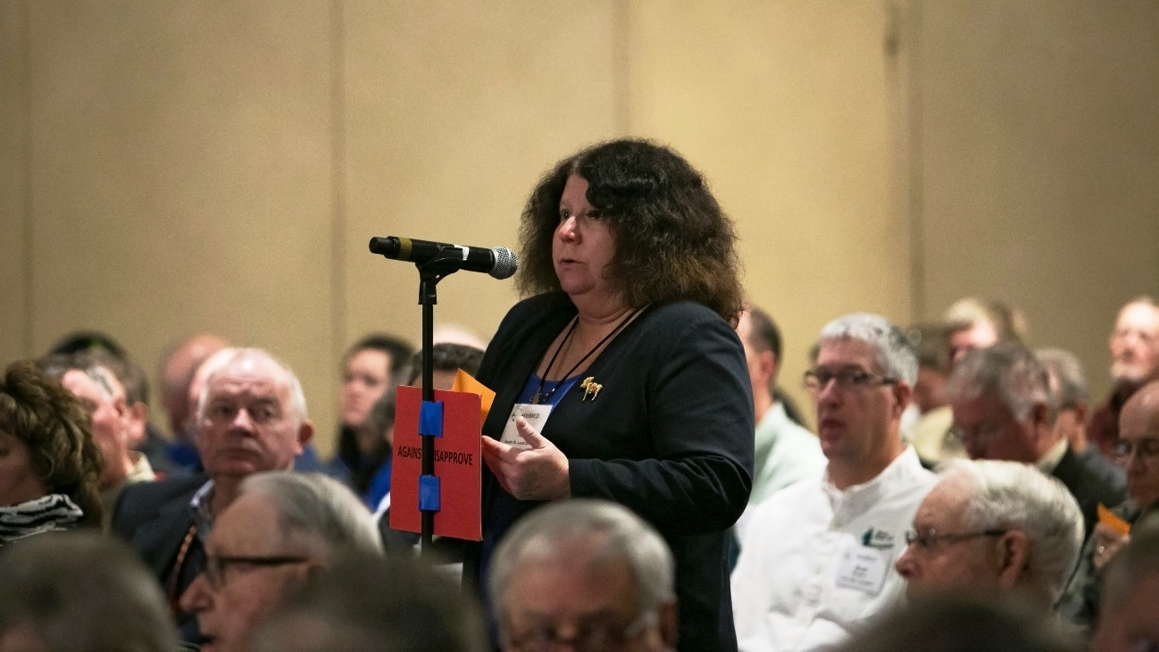
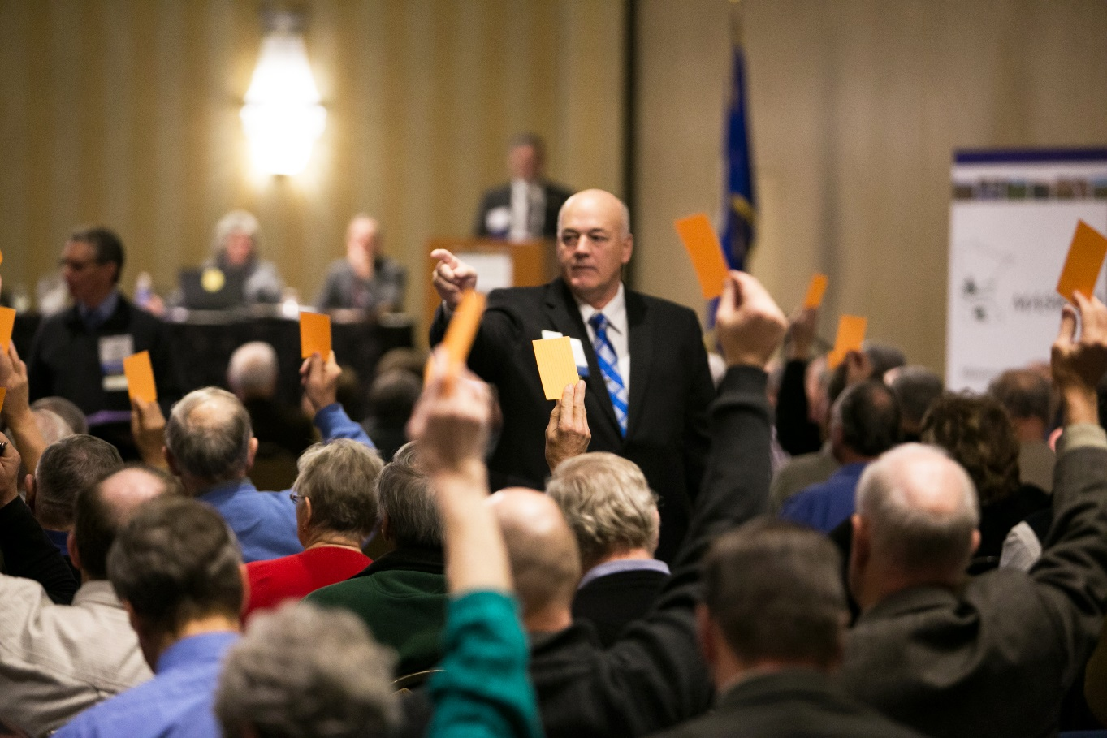

MASWCD = Grass Roots

Slide 12
SWCD Resolution
December 2011 SWCD Resolution:
THEREFORE, BE IT RESOLVED, that MASWCD pursue funding options for SWCDs that include authorization of an SWCD levy.

Slide 13
SWCD Work Group
2012 MASWCD Workgroup
SWCD Essential Services: Worked with BWSR
Assessed Additional SWCD Funding Options
Shared Responsibilities Between State & Local

Slide 14

2015 SWCD Funding Initiative
State Local Matching Grant Concept (Sparks/Torkelson)
Ultimately Legislature appropriated $11 million per year ($22 M) from Clean Water Funds
And Env & Nat. Res. Finance bill included language with “tails” to increase BWSR’s general fund appropriations by $22 million for grants to SWCDs for next biennium

Slide 15
SWCD Capacity Funding
FY 18-19 $11 million a year; proposed in BWSR’s General Fund but funded from Clean Water Funds
FY 20-21 $12 million a year; ultimately appropriated from Clean Water Funds

Slide 16
MASWCD Proposed
Funding Options to Date
MASWCD General Fund via BWSR
SWCD ad valorem property tax
SWCD soil & water management fee option

Slide 17
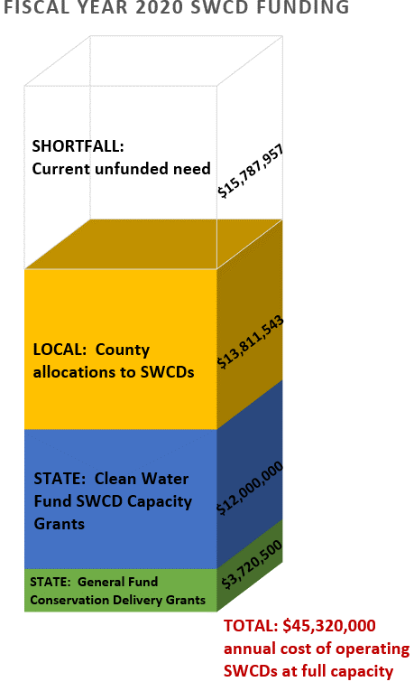
SWCD Funding

Slide 18
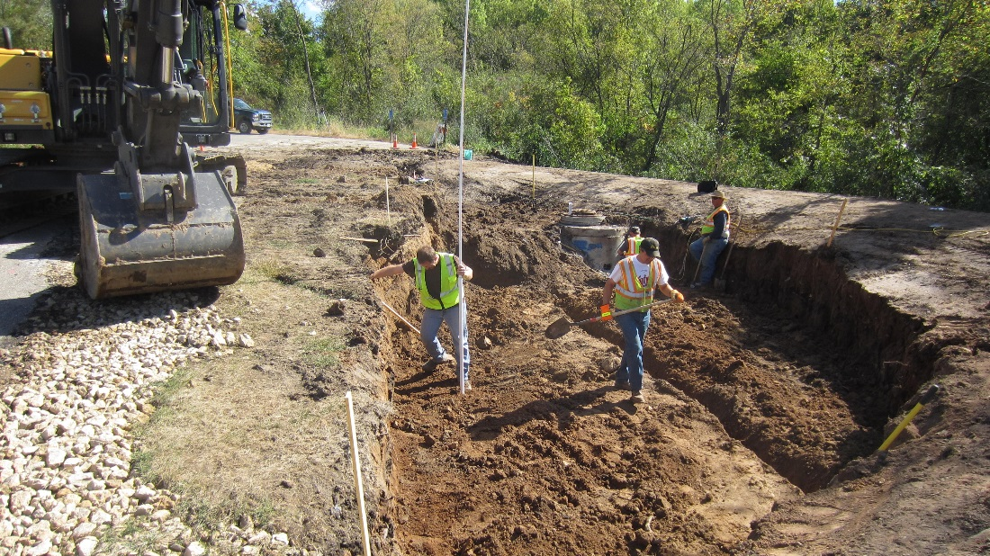
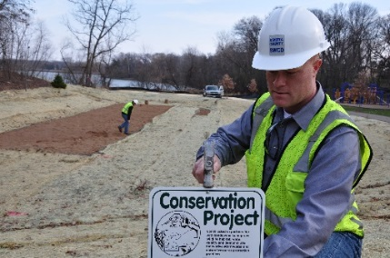
SWCDs Funding Accelerates
Water Quality & Soil Health Projects

